Slide 1
GPP Exam: Zombie AI

Slide 2
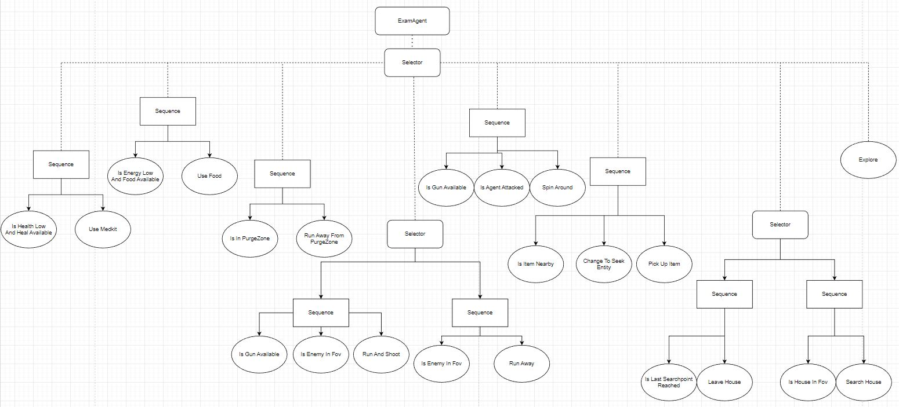
Decision Making

Slide 3
Enemy handling
Shooting, Aim, Spin Around when attacked, sprint while searching house on low health/energy, avoid agent in fov

Slide 4
Inventory
finds open slot and fills it in
If inventory is full it checks if item is already inventory and takes the better item (example: gun with less ammo gets replaced)
If inventory is full and item is not picked up yet it replaces a random item
Destroys garbage if there is an open slot else ignores it

Slide 5

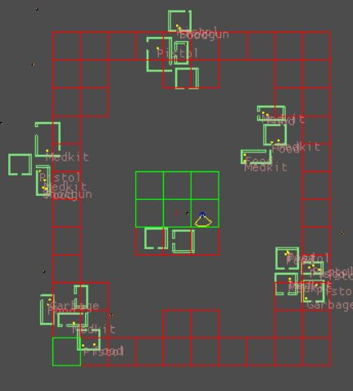
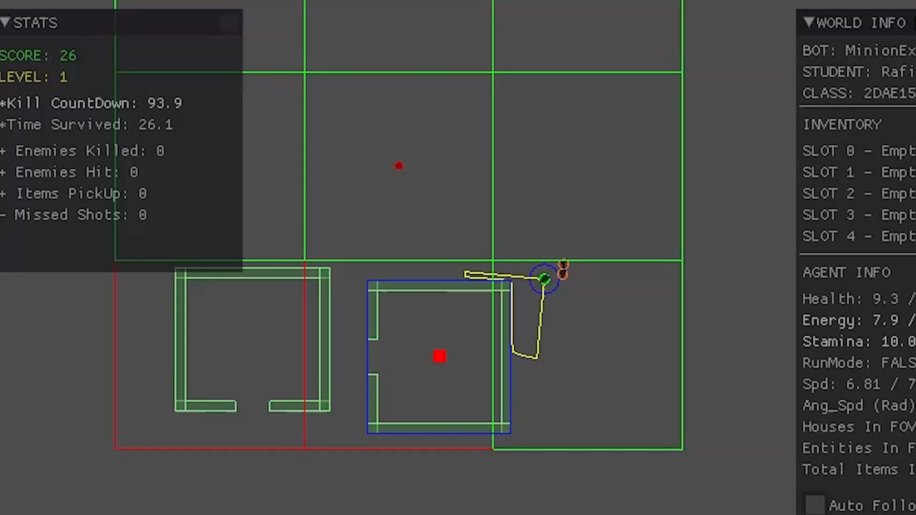
Movement & exploration
I have a predetermined set of cells that my agent explores and it always takes the closest cell to the agent
When a house is the fov of my agent it start searching predetermined points in the house, when it is done it leaves the house by seeking the last location before the house searching started
It uses seek, flee, face and spin around behavior in different situations
It also escapes PurgeZones by saving a location outside the cirlcle and sprinting outside, once outside if fov is in purgeZone radius agent get pushed because of flee behaviour

Slide 6
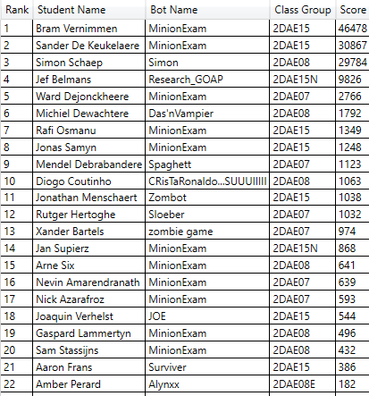
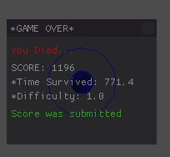
High Score

